Slide 1
PORTFOLIO OPTIMIZATION
By TEAM 6

Slide 2
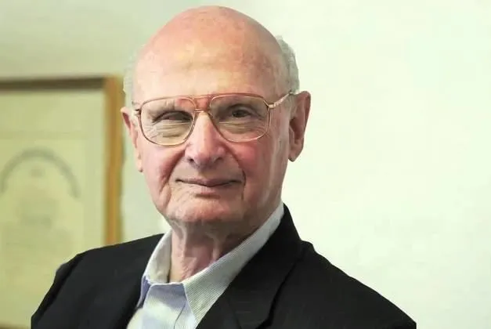
Portfolio Optimization: ●Portfolio Optimization is Based on Modern Portfolio Theory(MPT) or Mean- variance Analysis is a Mathematical Model Study For Developing and Creating of Portfolio for Which Aim to Maximize the Return For given Amount Of Risk. ●MPT Theory was Developed by Harry Markowitz in the 1950’s,He was Awarded The Nobel Prize.
Modern Portfolio Theory(MPT):
●Markowitz Provides the tools for Identifying the Portfolio which give the highest return for a Particular level of Risk(mean-variance portfolio throey).
●Total risk of the Portfolio can be Reduced by Diversification-this can be achieved by Investing in assets that have Low Positive Correlation,or Better still,a Negative Correlation.

Slide 3
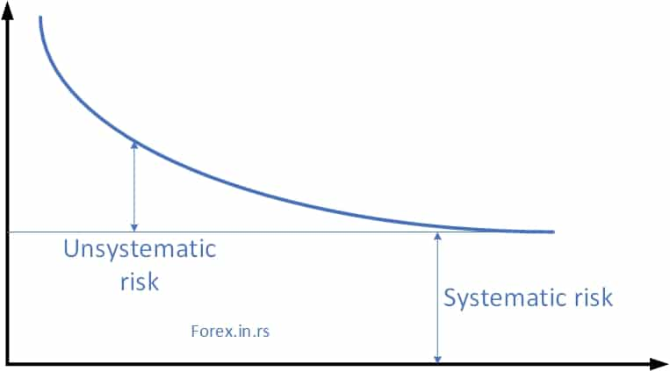
According to MPT,risk comes in Two categories: Systematic Risk: Systematic risk is the Risk that Influences a large Number of assets also called as Market Risk. Unsystematic Risk: Unsystematic Risk is the Risk that Influences a Single company (or)group of Companies also called Unique Risk or Firm-Specific Risk. Total Risk=Systematic Risk+Unsystematic Risk.

Slide 4
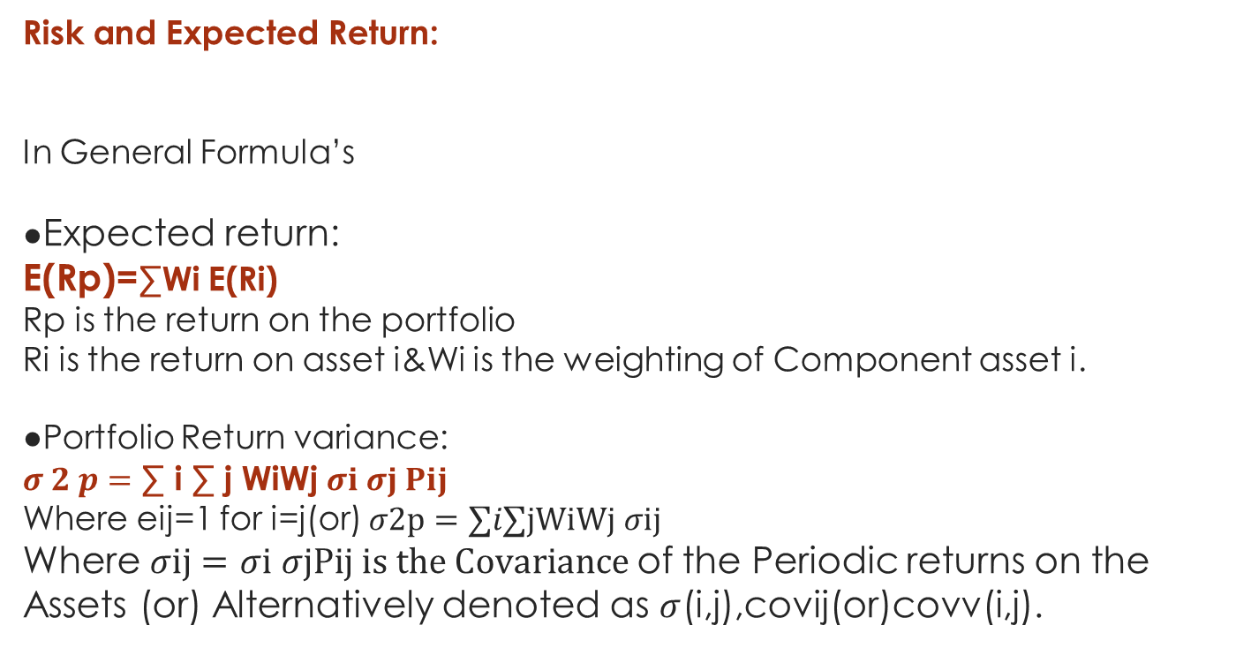
Risk and Expected Return: In General Formula’s ●Expected return: E(Rp)=∑Wi E(Ri) Rp is the return on the portfolio Ri is the return on asset i&Wi is the weighting of Component asset i. ●Portfolio Return variance: $σ 2 p=$ ∑ i ∑ j WiWj$σi$ $σj Pij$ Where eij=1 for i=j(or) $σ2p=∑i∑jWiWj$ $σij$ Where $σij=$ $σi$ $σjPij is the Covariance$of the Periodic returns on the Assets (or) Alternatively denoted as $σ$(i,j),covij(or)covv(i,j).

Slide 5
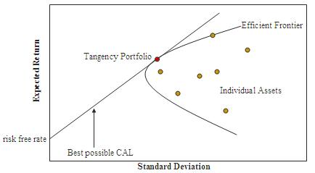
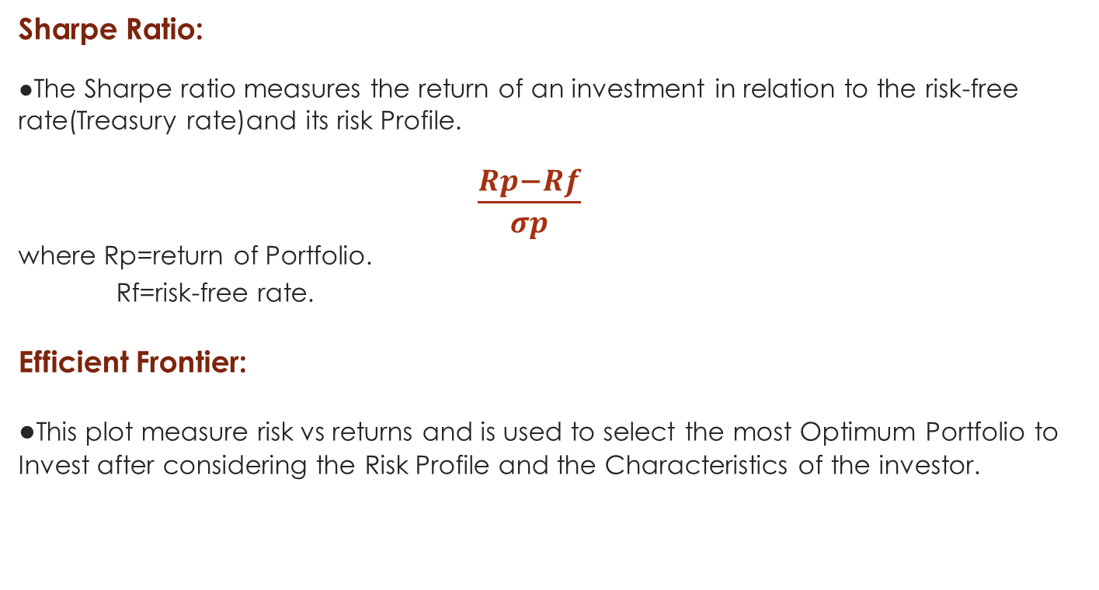
Sharpe Ratio: ●The Sharpe ratio measures the return of an investment in relation to the risk-free rate(Treasury rate)and its risk Profile. $\frac{Rp−Rf}{σp}$ where Rp=return of Portfolio. Rf=risk-free rate. Efficient Frontier: ●This plot measure risk vs returns and is used to select the most Optimum Portfolio to Invest after considering the Risk Profile and the Characteristics of the investor.

Slide 6
Statement : There are two assets , We have to Minimize the risk and get more Expected returns of the Companies on Monthly Basis data.
Date | HUL | SBI | %returns HUL | %returns SBI | Rp
Nov-19 | 855.4 | 260 |  |  |  |  | HUL | SBI | Rp | S.D
Dec-19 | 865.9 | 269.2 | 1.23% | 3.54% | 2.38% |  | 0.00% | 100.00% | 1.92% | 8.80%
Jan-20 | 911.75 | 292.6 | 5.30% | 8.69% | 6.99% |  | 10.00% | 90.00% | 2.14% | 8.04%
Feb-20 | 934.95 | 289.45 | 2.54% | -1.08% | 0.73% |  | 20.00% | 80.00% | 2.36% | 7.30%
Mar-20 | 1067 | 288.55 | 14.12% | -0.31% | 6.91% |  | 30.00% | 70.00% | 2.57% | 6.60%
Apr-20 | 1079.6 | 273.6 | 1.18% | -5.18% | -2.00% |  | 40.00% | 60.00% | 2.79% | 5.95%
May-20 | 1155.75 | 312.55 | 7.05% | 14.24% | 10.64% |  | 50.00% | 50.00% | 3.00% | 5.36%
Jun-20 | 1219.75 | 277.35 | 5.54% | -11.26% | -2.86% |  | 60.00% | 40.00% | 3.22% | 4.86%
Jul-20 | 1173.9 | 253.75 | -3.76% | -8.51% | -6.13% |  | 70.00% | 30.00% | 3.44% | 4.48%
Aug-20 | 1237.45 | 305.8 | 5.41% | 20.51% | 12.96% |  | 80.00% | 20.00% | 3.65% | 4.25%
Sep-20 | 1272.45 | 320.45 | 2.83% | 4.79% | 3.81% |  | 90.00% | 10.00% | 3.87% | 4.20%
Oct-20 | 1367.85 | 309.5 | 7.50% | -3.42% | 2.04% |  | 100.00% | 0.00% | 4.09% | 4.32%
Nov-20 | 1369.35 | 312.75 | 0.11% | 1.05% | 0.58%
Mean | 4.09% | 1.92%
Variance | 0.19% | 0.78%
S.D | 4.32% | 8.80%
Correlation | 0.24504541
Portfolio | 50% | 50%
Rp | 3.00%
S.D | 5.36% | 5.36%

Slide 7
Interpretation: X-axis are Risk-Standard Deviation,Y-axis are Return-Mean. ●On the X-axis it represents Standard Deviation all the Riskness. ●On the Y-axis it represents Mean all the Returns.

Slide 8
Objective: The main objective of the Modern Portfolio theory is that it Minimize the Risk & Maximize the Expected Return. Decision Variables: These Variables represents the Investment levels in each of the Two Assets. Conclusion: ●The main idea or the Purpose of the Modern Portfolio theory says that the risk is undertaken and return expected linked directly. ●In Order to achieve the greater rate of expected returns,an investor must have to take a high risk. ●This theory says that the Overall risk of the Portfolio having Securities can be reduced through the means of diversification.

Slide 9
By TEAM 6: Mohammad Nelofar Mohammed Mehdi Ali Mahitha palepu

Slide 10
THANK YOU.

